Slide 1
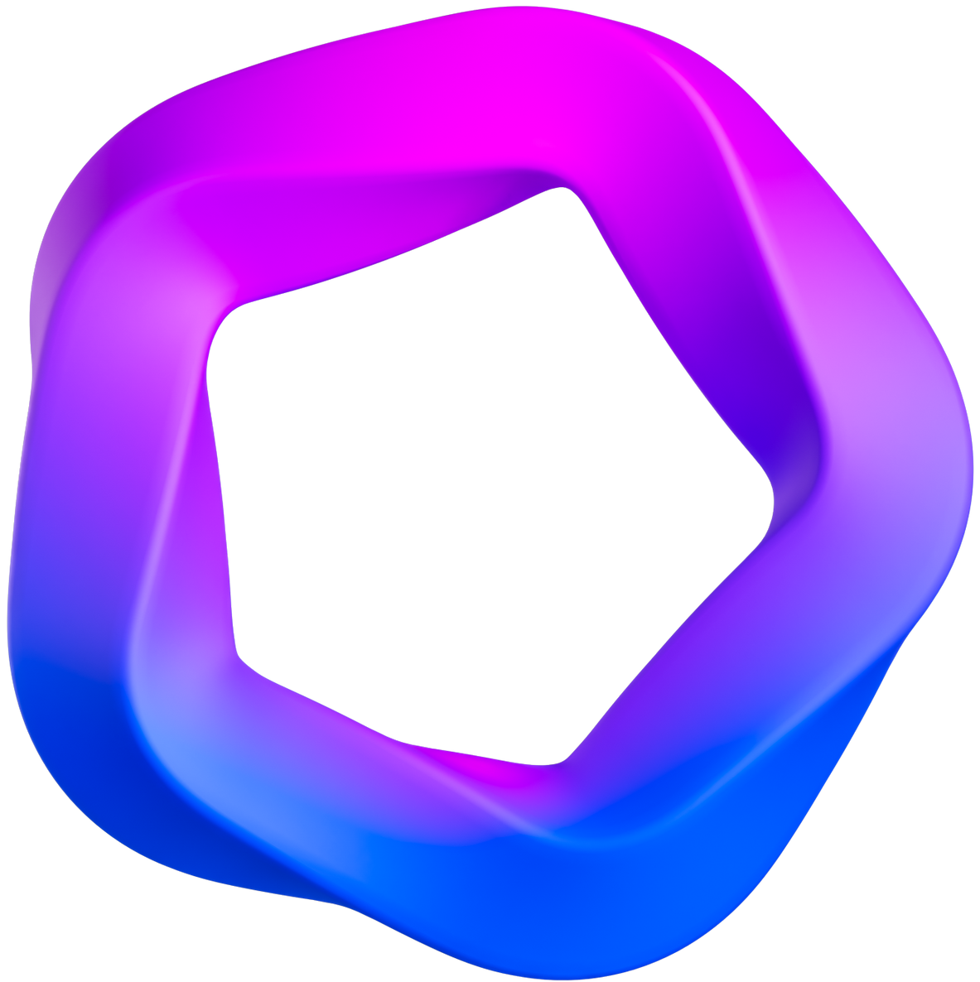
What's topdown approach and how to apply it?

Slide 2
TABLE OF CONTENS
Content 1
What is Top-Down?
Content 2
Why Top-Down?
Content 3
Different bottoms-Up Approach & Top-Down Approach
Content 4
Who Should Use Top-Down?
Content 5
When to Implement Top-Down?
Content 6
Where to Apply Top-Down?
Content 7
How to Apply Top-Down?

Slide 3
What is Top-Down?
Definition of Top-Down Approach:
Key Characteristics of Top-Down
Approach:
Top-down approach is a method of designing and building systems starting from the highest-level, big picture view of the system, defining the general necessary functions and behaviors. Then, the large system is broken down into smaller sub-systems, which continue to be broken down into specific components and modules.
Centralized Authority:
Decision-making authority is concentrated at the highest leadership level of the organization.
Comprehensive Strategy:
Finally, the detailed modules are implemented, integrated, and tested. The benefits of this method include having a clear overview of the entire system and setting clear goals/constraints for the sub-elements.
The strategy and overall direction are set from the top level, influencing every aspect of the organization.
Efficiency in Management:
Management and decision implementation are carried out effectively and in accordance with guidance from leadership.

Slide 4
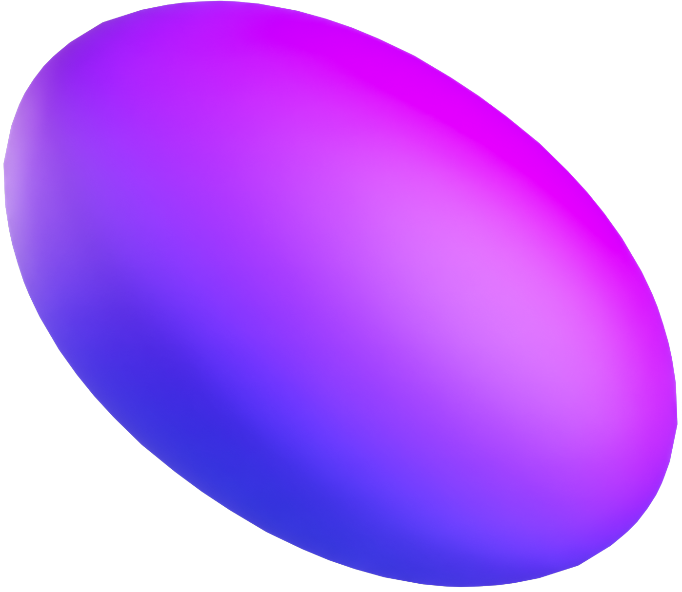

Why Top-Down?
Provides an overall system overview
Guides and constrains detailed design
Facilitates collaboration & organization
Earlier testing & detection of flaws
Prioritizes critical high-level elements firstNhắn Lobby

Slide 5
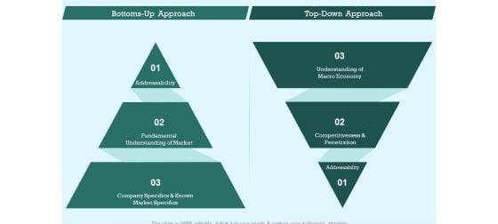
Different bottoms-Up Approach & Top-Down Approach

Slide 6

Who Should Use Top-Down?
Target Audience for Bottom-Up Approach:
Organizations or teams that value input and feedback from all levels of their workforce. Companies seeking to empower employees and encourage innovation from the grassroots level.
Relevant Industries:
Technology Startups: Bottom-Up Approach can be beneficial for fostering a culture of innovation and creativity, often seen in dynamic tech startups.
Creative Industries: Advertising agencies, design firms, and other creative industries can benefit from the diverse and varied ideas generated through a Bottom-Up Approach.
Successful Examples:
Google: Google encourages its employees to spend a portion of their work hours on personal projects, fostering innovation from the ground up.
Toyota: Toyota has successfully implemented Bottom-Up Approach in its production processes, empowering employees to contribute ideas for continuous improvement.

Slide 7



When to Implement Top-Down?
Guidelines:
Ideal Conditions:
Industry Trends:
Use during organizational change to harness perspectives.
Apply for innovation initiatives to spur creative thinking
Flat structure with decentralized decision-making Collaborative cultures valuing open communication
Aligns with shifting workforce preferring collaboration.
Allows frontline staff to contribute innovations with new technologies

Slide 8

Effective Application Areas:
01
Large-scale organizations with hierarchical structure
Strategic planning initiatives to align with organizational goals
Suitable Environments:
02
Stable, predictable work environments Industries with strict regulatory compliance
Where to Apply Top-Down?
Considerations for Implementation:
03
Clear communication channels from leadership to all levels
Alignment among leadership on vision and strategic goals

Slide 9
How to Apply Top-Down?
Define Vision and Outcomes
Leadership defines the vision, mission, and desired overall system outcomes
Map High-Level Architecture
Decompose the system into main sub-systems and components
Outline specifications of components
Define interfaces between elements
Determine Implementation Sequence
Prioritize critical foundation elements first
Sequence builds from stabilized sub-systems to detailed modules
Assign Roles & Responsibilities
Align teams to sub-system workstreams
Manage dependencies across groups
Verify Integration Continuously
Confirm components integrate properly
Validate system behavior meets goals
Adjust as Needed But Retain Vision
Refine specifications as issues emerge
But maintain alignment with original strategy and architecture

Slide 10
Thank you

